Slide 1


Samantha Hardy presents…
The Melodrama of Conflict
© Conflict Coaching International 2012

Slide 2
http://youtu.be/hUzzy0BnSN0
© Conflict Coaching International

Slide 3

The Melodrama of Conflict
© Conflict Coaching International

Slide 4
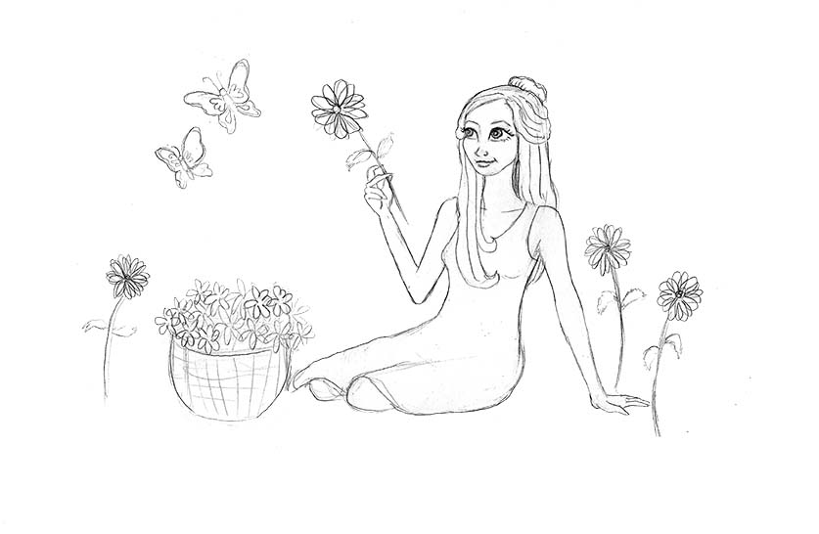
Heroine
Virtuous (necessary in order to gain sympathy and motivate others to help her)
Passive and helpless (acted upon, mute, needs someone to rescue her, stuck with no choices)
© Conflict Coaching International

Slide 5
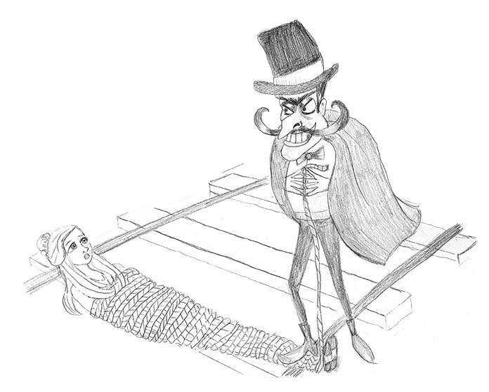
Villain
De-personalised
Evil (always assumed to have bad intentions)
Active and powerful
Upsets the status quo
© Conflict Coaching International

Slide 6
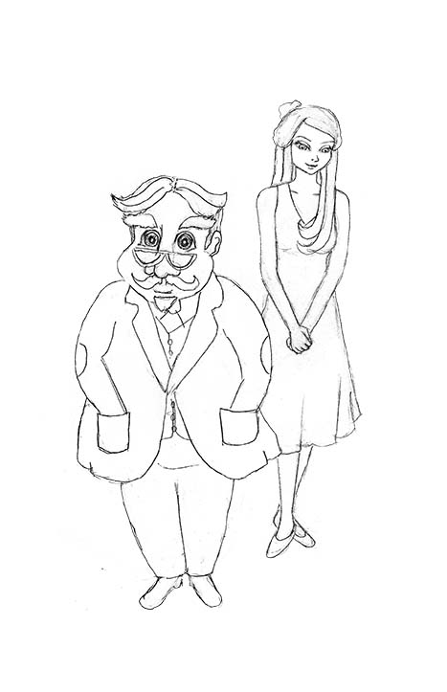
Father Figure
Powerful
Smart
Recognises heroine’s virtue
Punishes villain
Restores status quo
© Conflict Coaching International

Slide 7
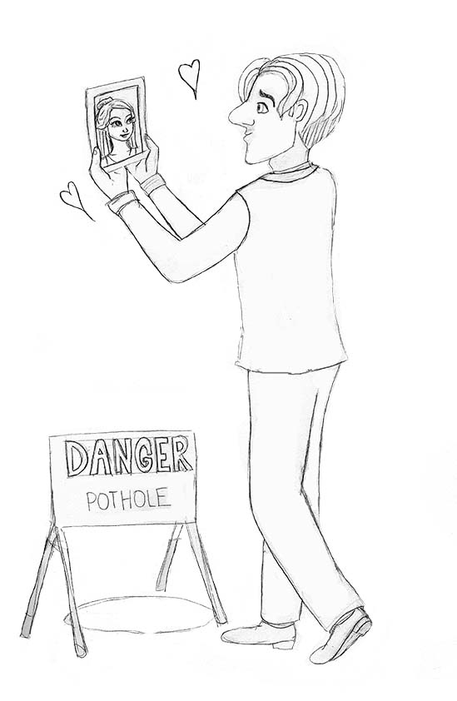
Hero
Totally devoted to heroine
Practically useless
Not as smart as villain
Although well-intentioned, can sometimes make things worse
© Conflict Coaching International

Slide 8
Melodramatic Plot
Sensational
Giant leaps, plot twists
Villain challenges heroine’s virtue
Fight to recognise and restore virtue
Villain over-powered
Dream justice
© Conflict Coaching International

Slide 9
The Tragedy of Resolution
© Conflict Coaching International

Slide 10
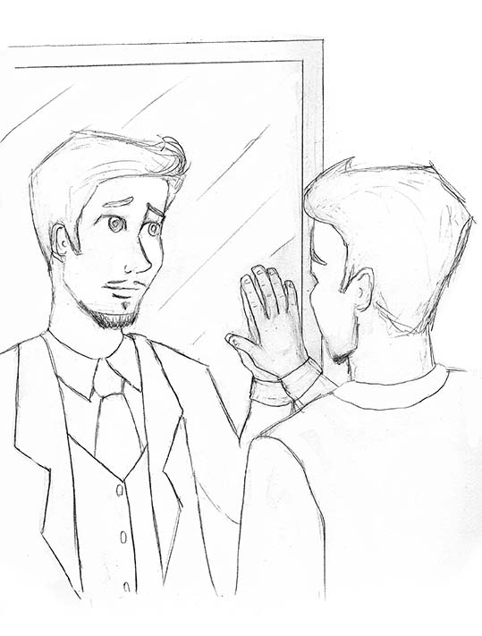
Tragedy, choice and learning
Complicated plots
Characters neither good nor bad, complex and flawed
Hero has to talk himself through the problem
Hero has choices (although may not be easy ones)
May not be a happy ending, but always learning and growth
© Conflict Coaching International

Slide 11
Coaching the client to develop her/his inner hero.
© Conflict Coaching International

Slide 12
The Conflict Coach
Refuse to play the role of father figure – stay with the client as bumbling melodramatic hero.
  On the client’s side, empathetic
  But practically useless
Be the mirror to help client talk to self
Help the client turn from helpless heroine
to active hero
© Conflict Coaching International

Slide 13
Working with the client’s story
Ask the client to set a goal – take responsibility right from the start.
Personalize the villain – ask for their name and keep using it.
Help client to complexify characters and plot.
© Conflict Coaching International

Slide 14
Working with the client’s story
Complexify the story – ask for details (without challenging).
  Ask about client’s actions.
  Ask about history (pre-villain’s action).
  Ask about other characters.
  Use non-universal language and unpack universals used by client.
  Use tentative language to explore the villain’s actions and motivations, explore possibilities even where client is dismissive.
© Conflict Coaching International

Slide 15
Working with the client’s story
Highlight past choices (good and bad).
Explore the client’s suffering.
Ask the client to tell the story from other perspectives (role play a different character).
Carefully challenge the notion of dream justice.
Focus on choices and learning.
Focus on improvement and artistry (not a return to the status quo).
© Conflict Coaching International

Slide 16
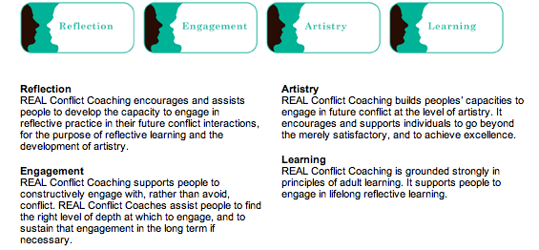
© Conflict Coaching International

Slide 17
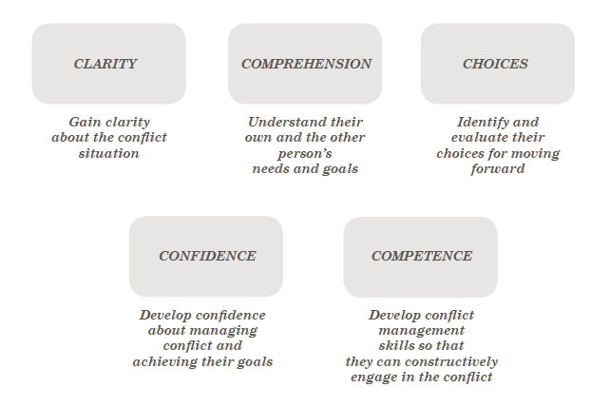
The 5 Cs
© Conflict Coaching International

Slide 18
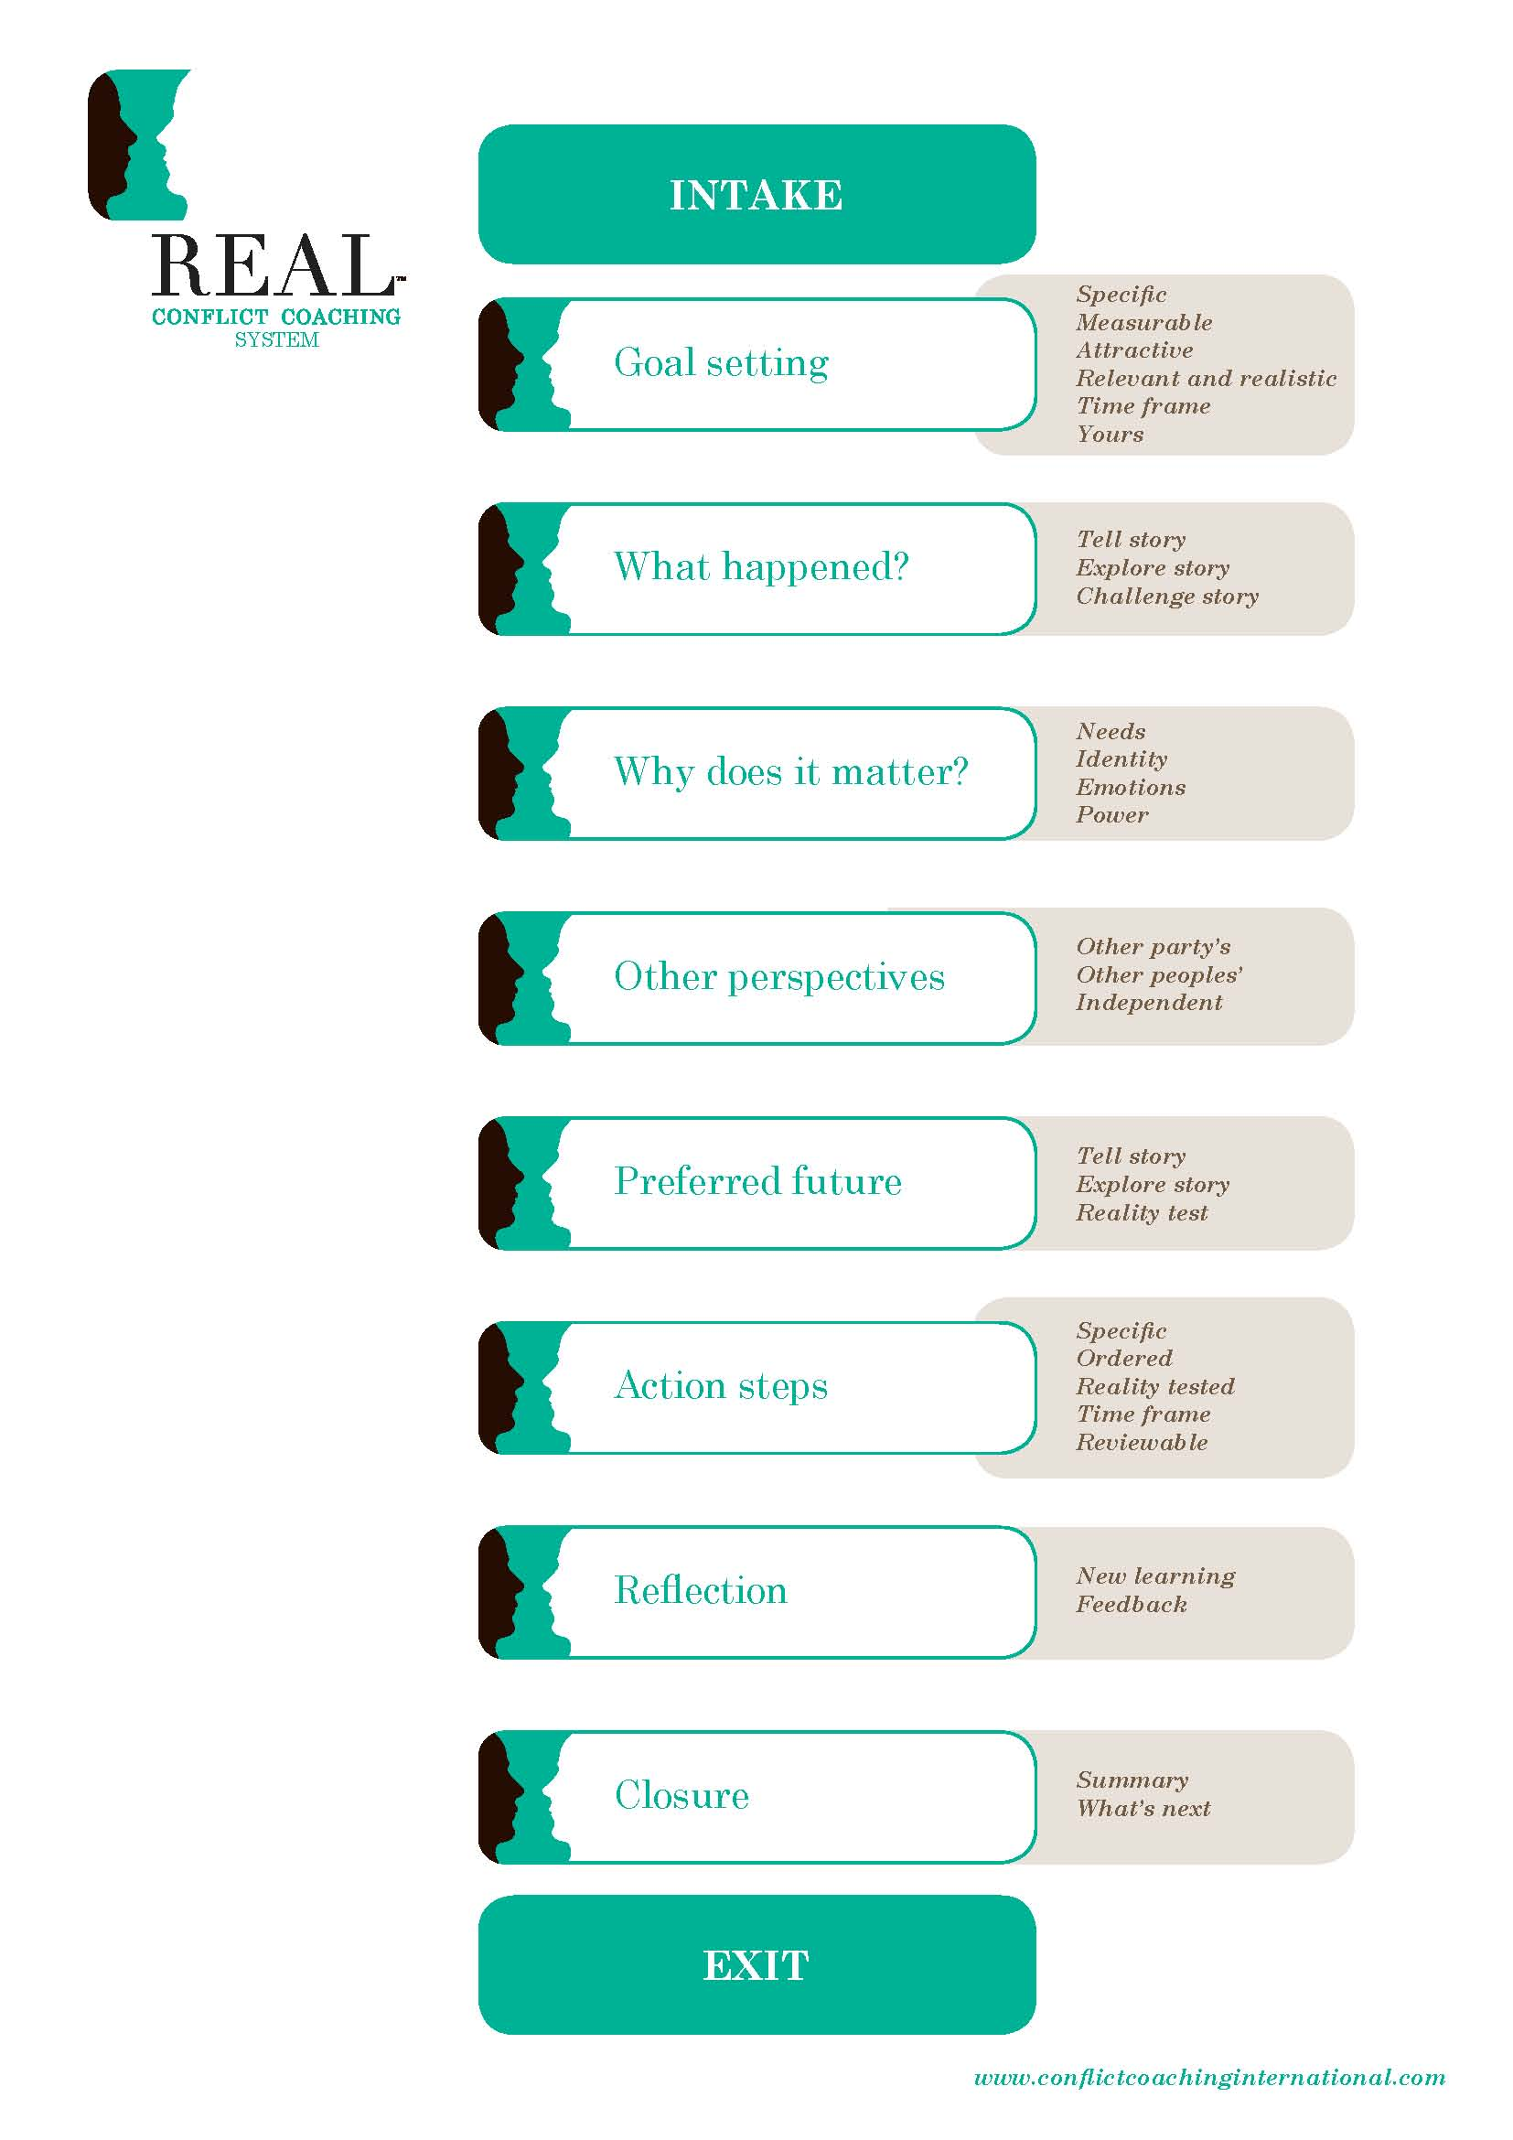
© Conflict Coaching International

Slide 19

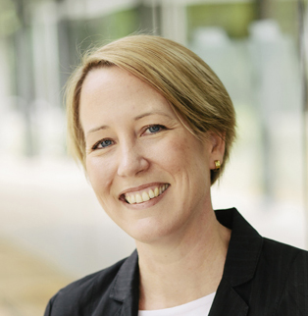
Conflict Coaching International
Samantha Hardy
sam@conflictcoachinginternational.com
571-279-2082 (until 4 October)
© Conflict Coaching International 2012

